Slide 1
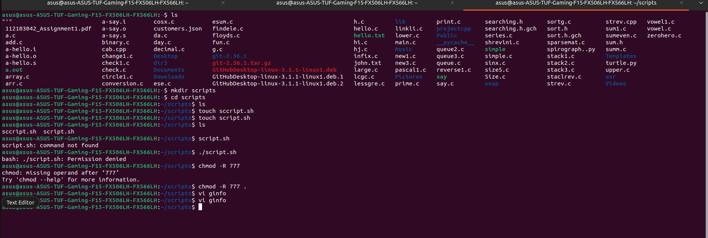
NAME- SHREEYA GANJI
MIS- 112103042
ASSIGNMENT 2- SHELL SCRIPTING

Slide 2

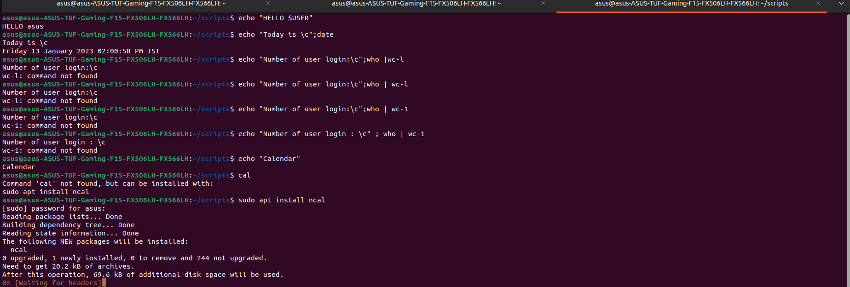
Echo command ,User defined Variables

Slide 3

More on user defined variables

Slide 4

SHELL ARITHMETIC

Slide 5
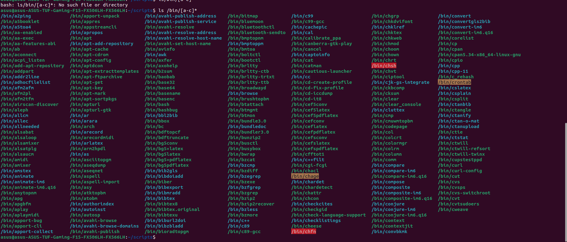

Slide 6

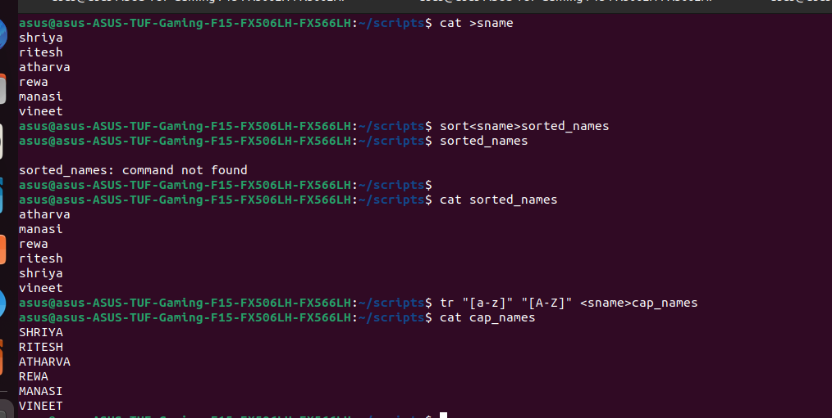
REDIRECTION OF STANDARD INPUT /OUTPUT

Slide 7
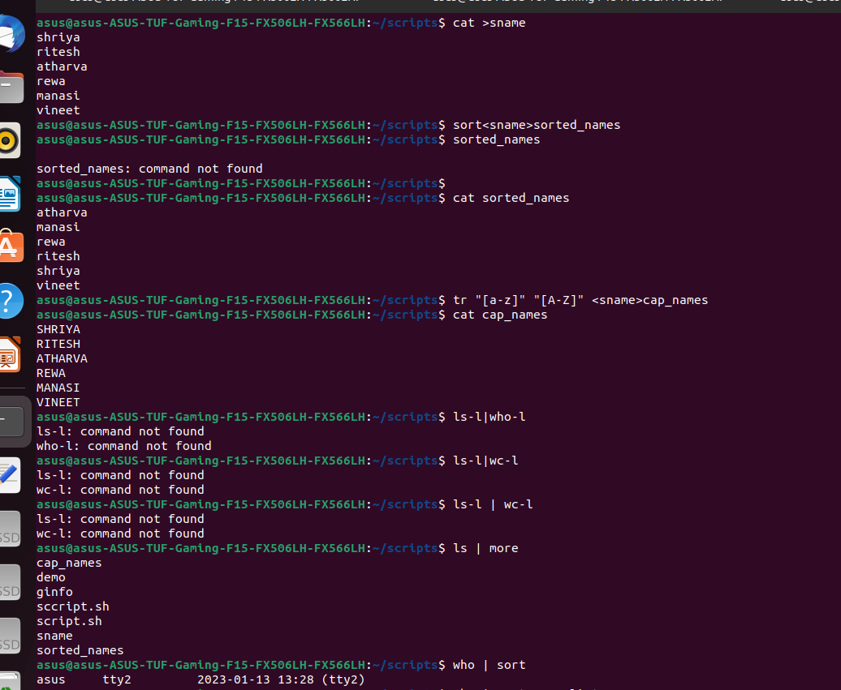
Redirection of standard input and output

Slide 8
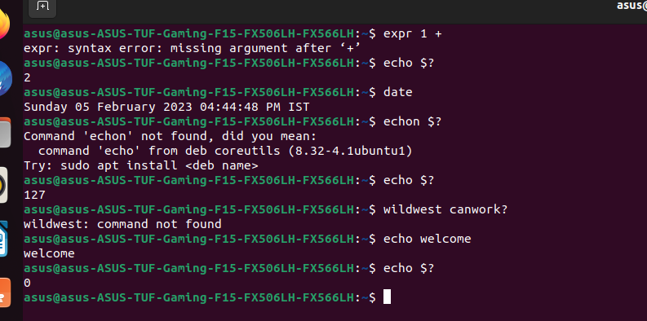
EXIT STATUS IN SHELL SCRIPTING

Slide 9



PASTE AND JOIN UTILITY
DATE MANIPULATION USING AWK UTILITY

Slide 10
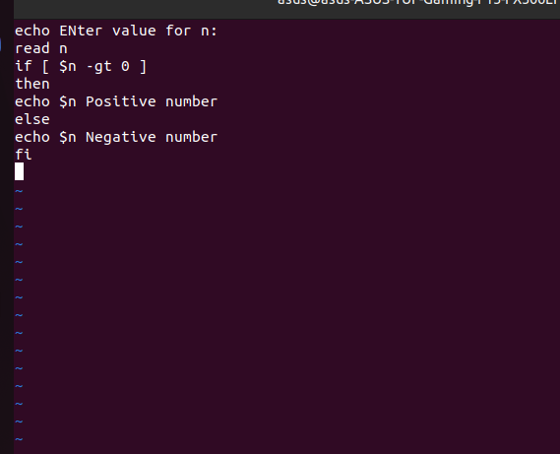

If -else statement

Slide 11


WHILE LOOP

Slide 12



Slide 13

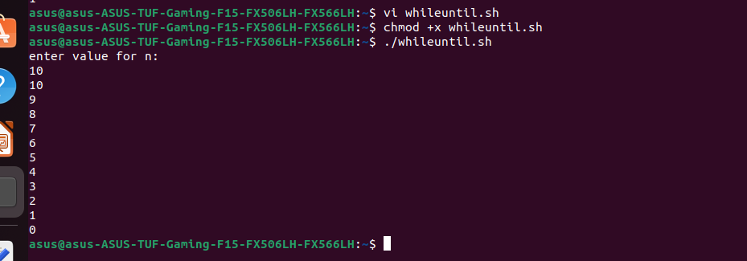

Slide 14



Slide 15
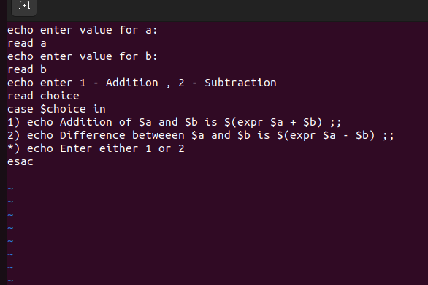
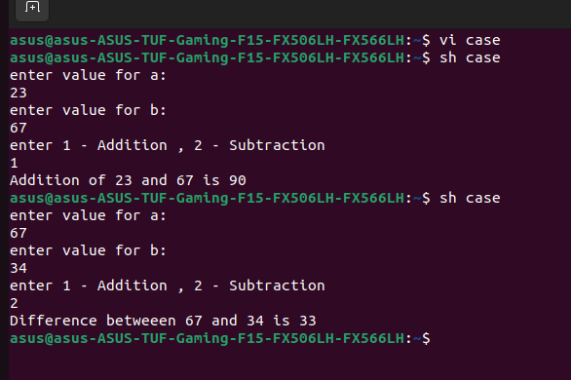
Case statement

